Slide 1

Distributed learning
Management system
Team Members
1.Asim Mandal
2. Bikranta Gochhayat
3. Dayanand Shanker Singh
4. Deepak nath

Slide 2
INTRODUCTION
In this digital age, people are getting much more connected than they have even been with the help of web or web-based service. Now a days we are so dependent, we can't even imagine our life without it. This type of connectedness can be further benefit the various or broad range in one such domain that can highly benefit for the people using them. Education is one such domain that can highly benefit for this.

Slide 3
Objective
The main objective for developing this e-learning management system to provide a user-friendly environment to provide knowledge and give everyone a chance to learn digitally take any class, anytime anywhere they want, with no additional software to download all you need is an Internet connection. Study at your own place and access course when it is convenient.

Slide 4
Technology use to design
Frontend: HTML(Hyper Text Markup Language) ,CSS(Cascading Style Sheet) , JavaScript
Server-side scripting : PHP (Hypertext pre-processor)
Backend : MySQL
Virtual Space : ASW Cloud

Slide 5
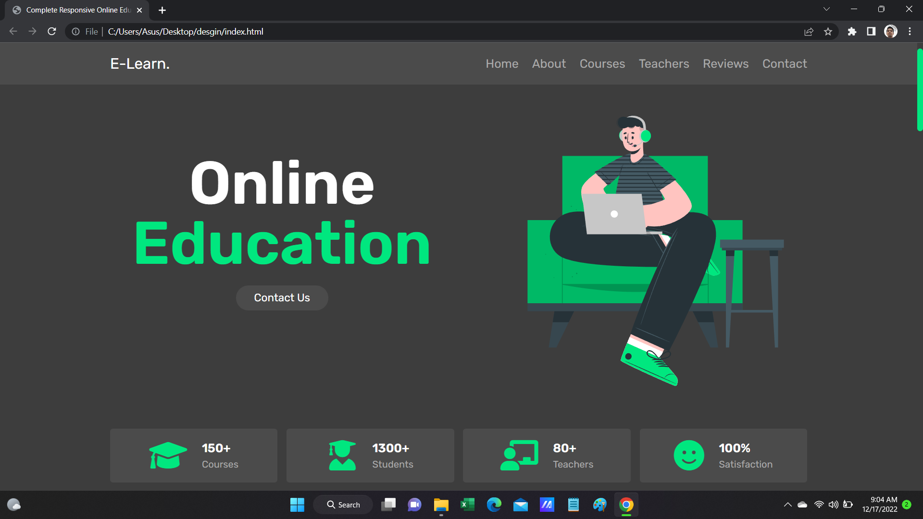
Website response according to devices
Desktop mode

Slide 6
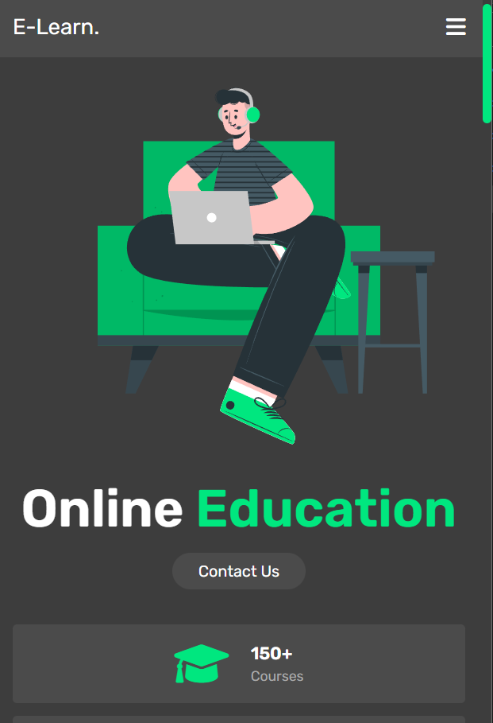
Website response according to devices
Mobile

Slide 7
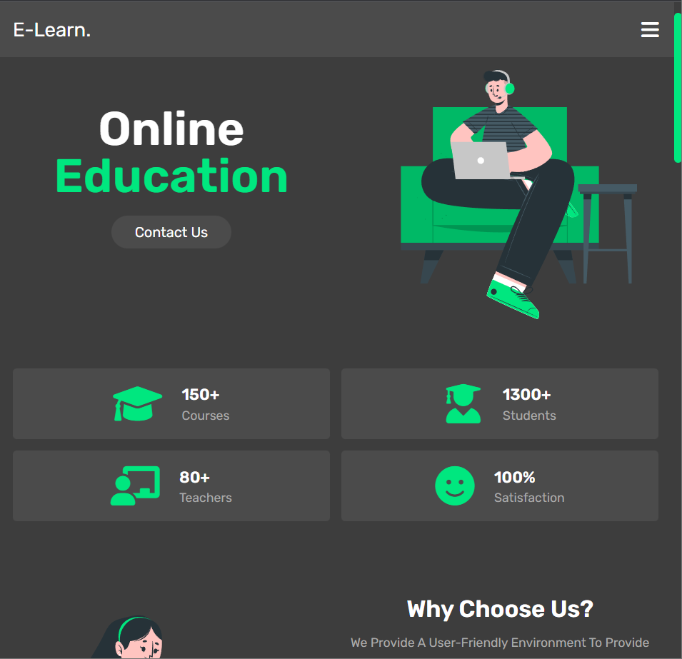
Website response according to devices
Tablet

Slide 8
Features
Platform can add mentors.
Teachers can add courses, assignment.
Student can take course.
Student can test themselves if they are understanding the material or not.
Student can give review.
Live classes facility.

Slide 9
Implementation

Slide 10
reference
https://www.youtube.com/watch?v=l1EssrLxt7E&list=PLfqMhTWNBTe3H6c9OGXb5_6wcc1Mca52n
https://www.youtube.com/watch?v=ER9SspLe4Hg&list=PLu0W_9lII9ahR1blWXxgSlL4y9iQBnLpR
https://www.researchgate.net/figure/Distributed-e-learning-management-system_fig2_271179394
Teacher
Friends

Slide 11
THANK YOU

